Slide 1
Project:
Flight data analysis
and
Fares Prediction

Slide 2
Outline
Why accurate prediction is important?
Understanding Dataset features
Project problem statement
Tools Used
Approach Used to solve this problem.
Key Findings
Best Model and Result
Conclusions

Slide 3
Why Predicting flight fares is important?
Tackle overpriced flight fares.
High price can be discouraging to potential customers.
Save booking time.
Fast booking and selling.
Price transparency for buyer and seller.
Better selection.

Slide 4
Problem Statement
We need to build a model using Machine Learning in order to analyse factors influencing flight fares and predict flight fares.

Slide 5
Tools Used
Python
Libraries: Numpy, pandas, sklearn, scipy
ML regression algorithms
Anaconda and Jupyter notebook

Slide 6
Approach or Process Involved in Analysis
Exploratory data analysis
Feature Engineering
Relation between different features/amenities of house and target column i.e. sales price.
Grouped Data Analysis to get more insights.
Correlation and identification of multicollinearity problem.
Identifying and Selecting best features that affect fare price.
Data pre-processing.
Model Initialization and evaluation.
Model Validation
Model Testing and Pipelining.

Slide 7
Understanding Dataset features
Columns in dataset: ['Departure Time', 'Arrival Time', 'Extra', 'From', 'To', 'Prices', 'total_time_taken_in_hours', 'Day of flight', 'date of flight', 'month of flight', 'stop_details', 'first_stop', 'second_stop', 'third_stop', 'fourth_stop', 'airline1', 'airline2', 'airline3', 'Price Range']
Shape of dataset: (1703 rows and 19 columns)

Slide 8
Feature Description:
From column contains data about from where the flights are leaving to Dubai so hair the data is perfectly from Delhi to Dubai so all the flights are living from Delhi only.
To column contains data for Dubai international airport and Abu dhabi international airport.
Since it is one week data the day of flights range from Monday to Sunday respectively and the month is January.
The stop details column contain whether the flight from Delhi to final destination is direct or there are one stop to or three or four stops in between them.
First stop second stop third stop and 4th stop column contain detail of stops such as different Indian states France etc.
Airlines one airline to airline 3 columns data contain airlines details that are flying between Delhi and Dubai. This data is regarding connecting flights between different stops.
We have distributed price column into 3 rangers namely average priced lower than average and expensive based on the fare price.

Slide 9
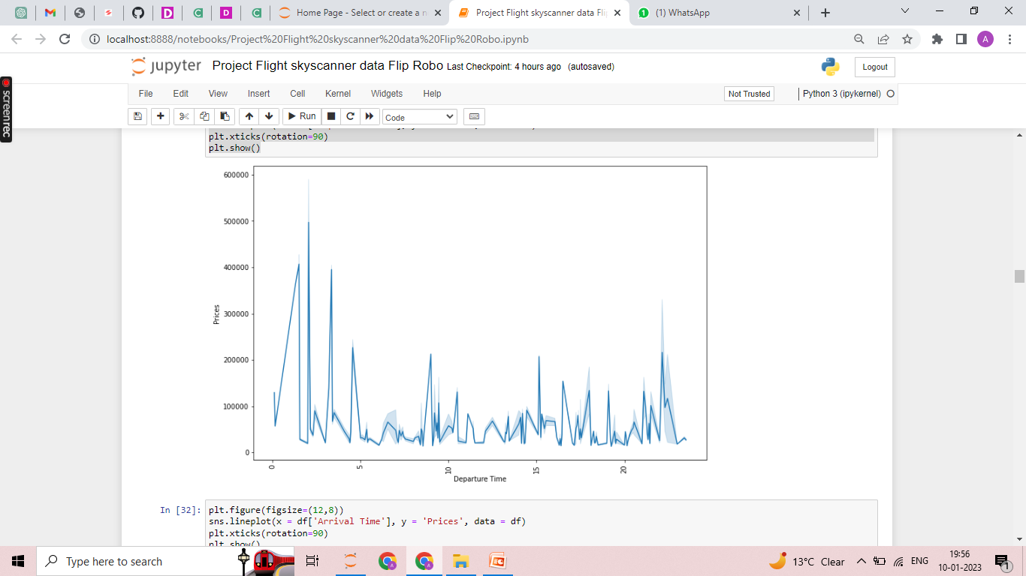
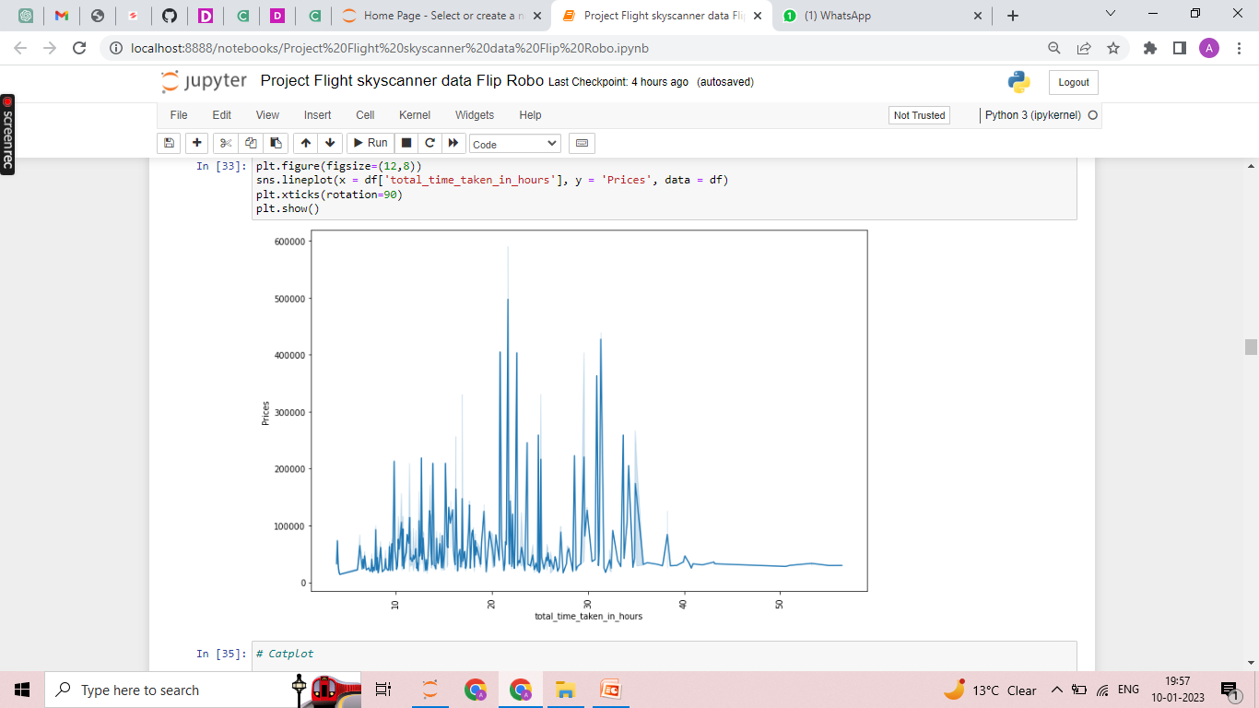
Visualisations

Slide 10
Data Analysis result
Most flights are landing at Dubai international airport.
Most flights are deboarding on Monday.
Most flights have at least one stop between point of departure and final destination.
For most flights first stop is Bombay.
Emirates Indigo and vistara are most common flights leaving for Dubai international airport.
Air India, Emirates, Ethiopian airlines, British Airways, Lufthansa, Swiss, Uzbekistan Airways, Jazeera Airways cafe Pacific or most expensive airlines and one must avoid booking flights in them.
Flights having departure time between 10 to 15 are lower than average priced.
Sri Lankan airlines, Indigo, SpiceJet are one of the cheapest airlines to Dubai.

Slide 11
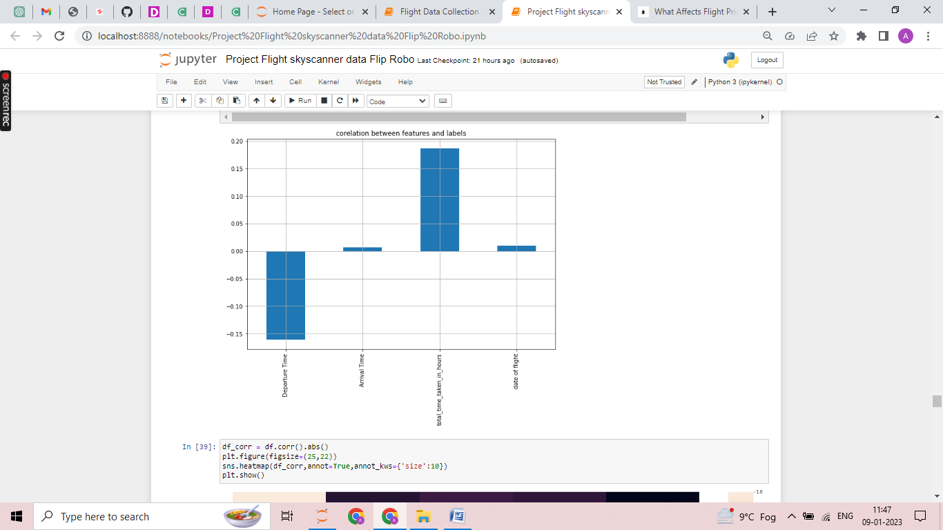
Key findings
Features positively related to Fare Price are indicated in graph:

Slide 12
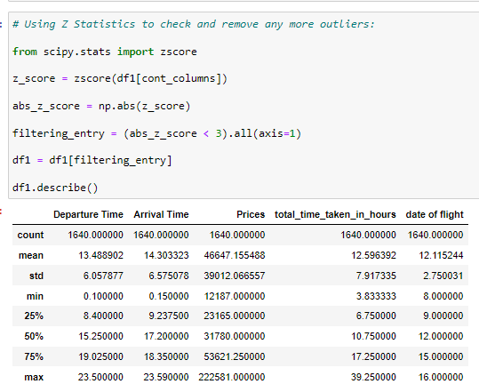
Removing Outliers

Slide 13
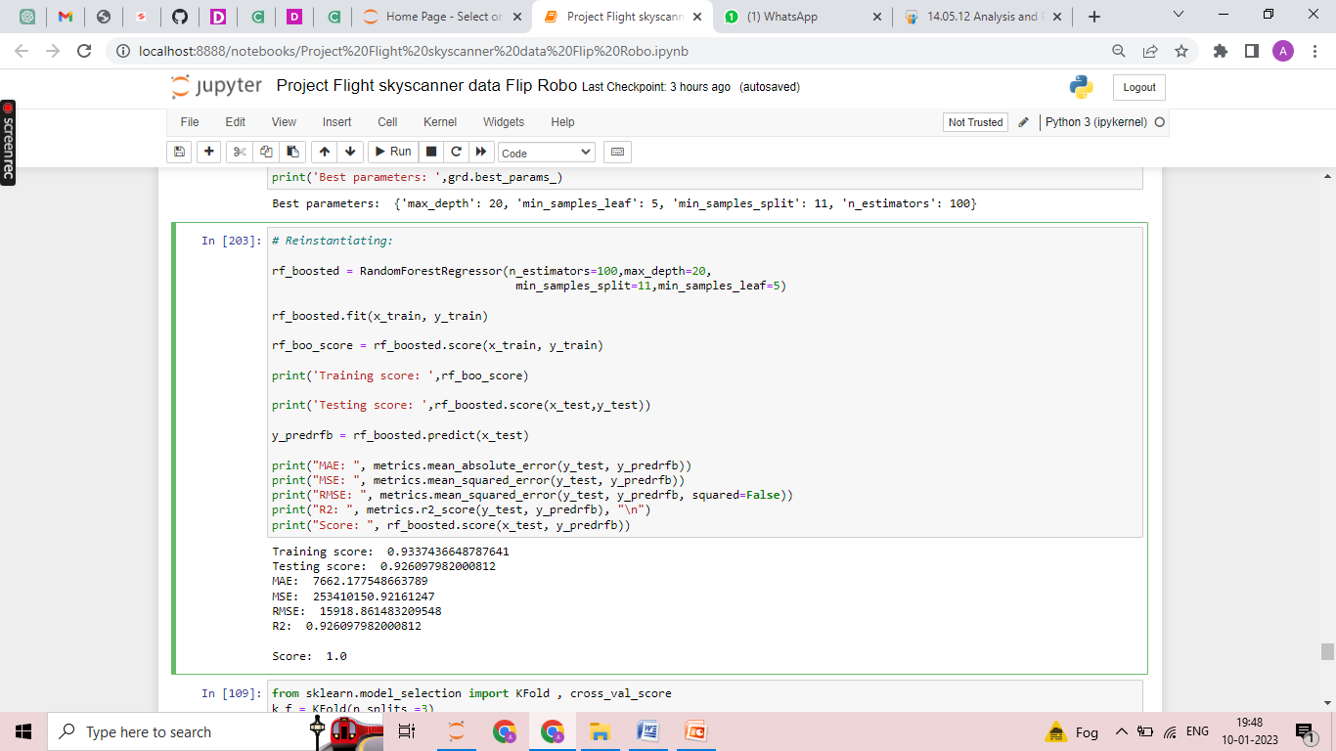
Best Model
(Random Forrest Regresssor)

Slide 14
Result
Random forrest regressor is the best model for predicting flight fares with 92 % testing accuracy and least error.
Random Forest Regressor:
Training score: 0.9337436648787641 Testing score: 0.926097982000812 MAE: 7662.177548663789 MSE: 253410150.92161247 RMSE: 15918.861483209548 R2: 0.926097982000812 Score: 1.0

Slide 15
Conclusion
Total time taken by flight has the most impact on ticket fares.
Flight tickets can be purchased prior and well in advance and departure time can be selected in the afternoon between 1pm to 3pm.
Air India, Emirates, Ethiopian airlines, British Airways, Lufthansa, Swiss, Uzbekistan Airways, Jazeera Airways cafe Pacific or most expensive airlines and one must avoid booking flights in them.
Sri Lankan airlines, Indigo, SpiceJet are one of the cheapest airlines to Dubai.

Slide 16
Thank You

